Slide 1
W4111 – Introduction to Databases Section 002, Spring 2026 Lecture 2: Foundation – ER, Relational, SQL (I)
COMSW4111_2026_01-Lecture-2– ER, Relational, SQL (I) © Donald F. Ferguson, 2025

Slide 2
Contents

Slide 3
Show HW tips and guidelines on Ed.

Slide 4
Contents
ER Model/Modeling:
More details
An example.
A deeper dive on keys.
Formal model for keys.
Some practical concepts for keys.
Relational Algebra:
π, σ examples
X (Cartesian Product)
⨝ (JOIN) operator
Continuing SQL
More details on SELECT
Cartesian Product
Join

Slide 5
Entity Relationship Entity Relationship Models

Slide 6
Modeling (Reminder/Review)

Slide 7
Modeling According to Wikipedia
Model-driven engineering (MDE) is a software development methodology that focuses on creating and exploiting domain models, which are conceptual models of all the topics related to a specific problem. Hence, it highlights and aims at abstract representations of the knowledge and activities that govern a particular application domain, rather than the computing (i.e. algorithmic) concepts.
In software engineering, a domain model is a conceptual model of the domain that incorporates both behavior and data.
A modeling language is any artificial language that can be used express data, information or knowledge or systems in a structure that is defined by a consistent set of rules. A modeling language can be graphical or textual.
Graphical modeling languages use a diagram technique with named symbols that represent concepts and lines that connect the symbols and represent relationships and various other graphical notation to represent constraints.
Textual modeling languages may use standardized keywords accompanied by parameters or natural language terms and phrases to make computer-interpretable expressions.

Slide 8

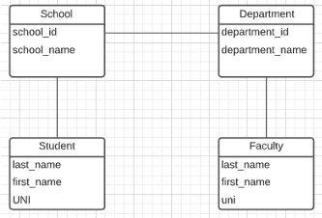
ER Model and ER Modeling
ER Model: Agility, Separation of Concerns
ER model is a generalization that most DB models implement in some form.
Using the ER model enables:
Thinking about and collaborating on design with getting bogged down in details.
Enable flexible choices about how to realize/Implement data.
ER Diagrams: Communication, Quality, Precision
With a little experience, everyone can understand and ER diagram.
Easier to discuss and collaborate on application’s data than showing SQL table definitions, JSON, ... ...
People think visually. That is why we have whiteboards. ER diagrams are precise and unambiguous.
Guides you to think about relationships, keys, ... And prevents “re-dos” later in the process. It is easier to fix a diagram than a database schema.
Abstract Model
ER Model
Concrete Models
Relational
... ...
Doc Model
Graph Model
UI UX
Business Professional
Business Service Developer
DB Pros

Slide 9
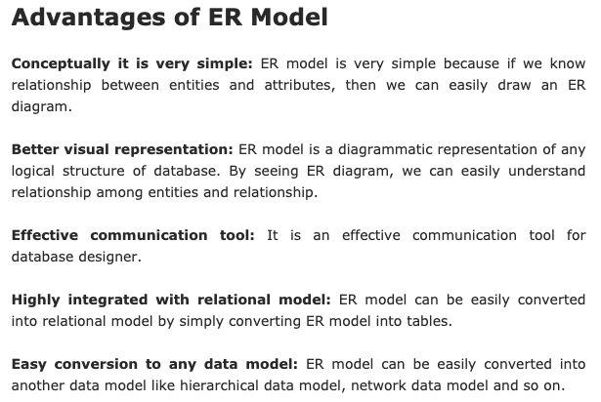
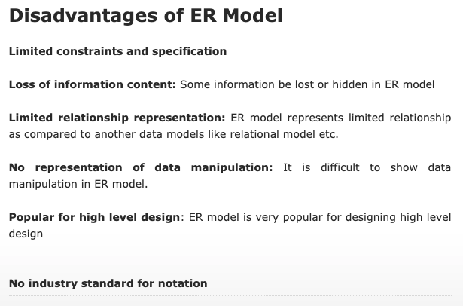
ER Modeling – Reasonably Good Summary
https://pctechnicalpro.blogspot.com/2017/04/advantages-disadvantages-er-model-dbms.html
Note:
If you get to use Google to help with take home exams, HW, etc.
I get to use Google to help with slides.

Slide 10
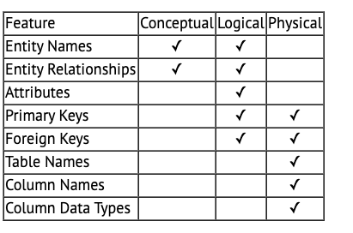
A Common and my Approach: Conceptual → Logical → Physical
https://ehikioya.com/conceptual-logical-physical-database-modeling/
https://www.1keydata.com/datawarehousing/data-modeling-levels.html
It is easy to get carried away with modeling. You can spend all your time modeling and not actually build the schema.
We will use the approaches in class.
Mostly to understand concepts and patterns.
https://www.1keydata.com/datawarehousing/data-modeling-levels.html

Slide 11
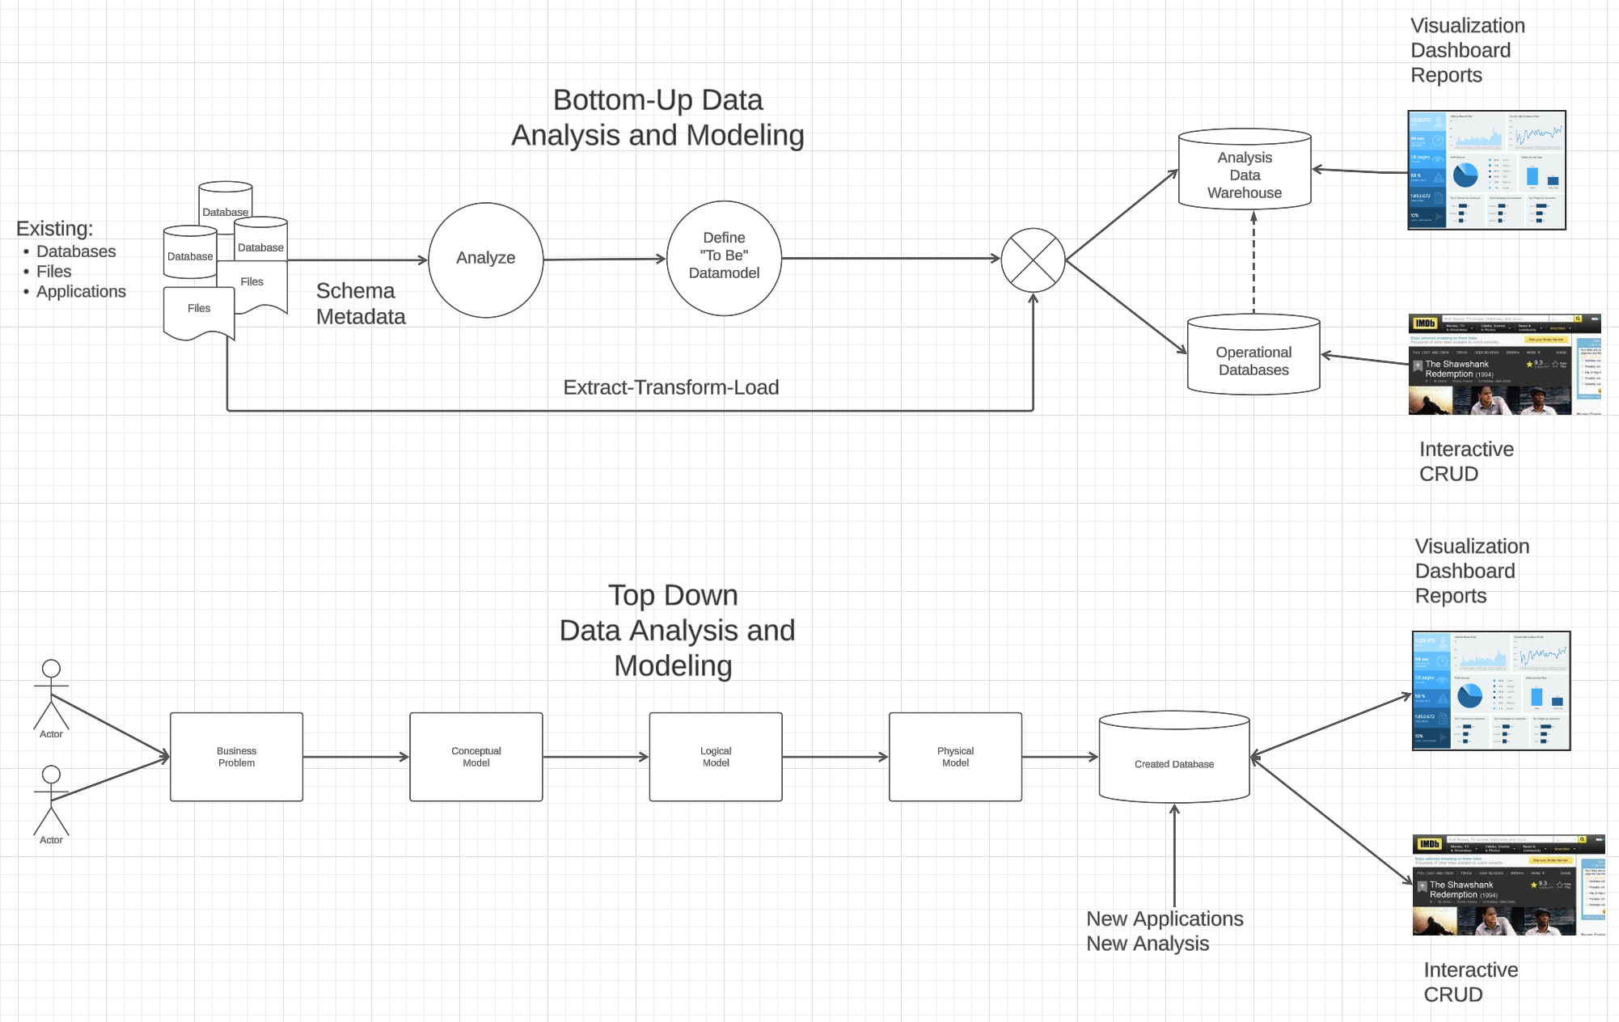
Modeling
Most of the time there is a mix → Meet-in-the-Middle

Slide 12
There are Many Languages/Notations

Slide 13
Summary of Symbols Used in E-R Notation

Slide 14
Symbols Used in E-R Notation (Cont.)

Slide 15
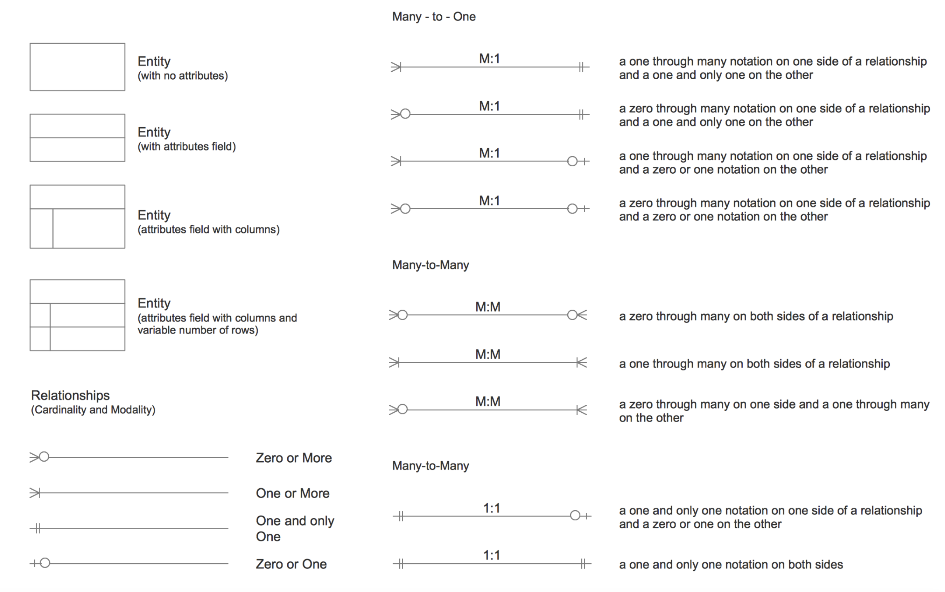
Crow’s Foot Notation

Slide 16
UML
UML: Unified Modeling Language
UML has many components to graphically model different aspects of an entire software system
UML Class Diagrams correspond to E-R Diagram, but several differences.

Slide 17
ER vs. UML Class Diagrams
* Note reversal of position in cardinality constraint depiction

Slide 18
ER vs. UML Class Diagrams
ER Diagram Notation
Equivalent in UML
* Generalization can use merged or separate arrows independent
of disjoint/overlapping

Slide 19
Modeling Summary
If you are in a project/team meeting and draw a diagram on the whiteboard/chalk board, you are probably “visual modeling.”
A visual notation is simply an agreement on precisely defining what the symbols, lines, colors, … … “mean.”
Even within a well-defined notation, people are often lazy or class but use slightly different interpretations/notations.
The two key concepts are:
Everyone in the process agrees on the meanings and adheres to them.
You do “just enough” modeling:
No modeling ➔ You are randomly, frantically coding like a slam poet.
Too much modeling ➔ You spend all of your time arguing and never deliver the project.
We will take an approach to Crow’s Foot Notation in the class, but will also examine the modeling language that comes with the book. This is a good fit with relational databases and relational model concepts.

Slide 20
Our First Example

Slide 21
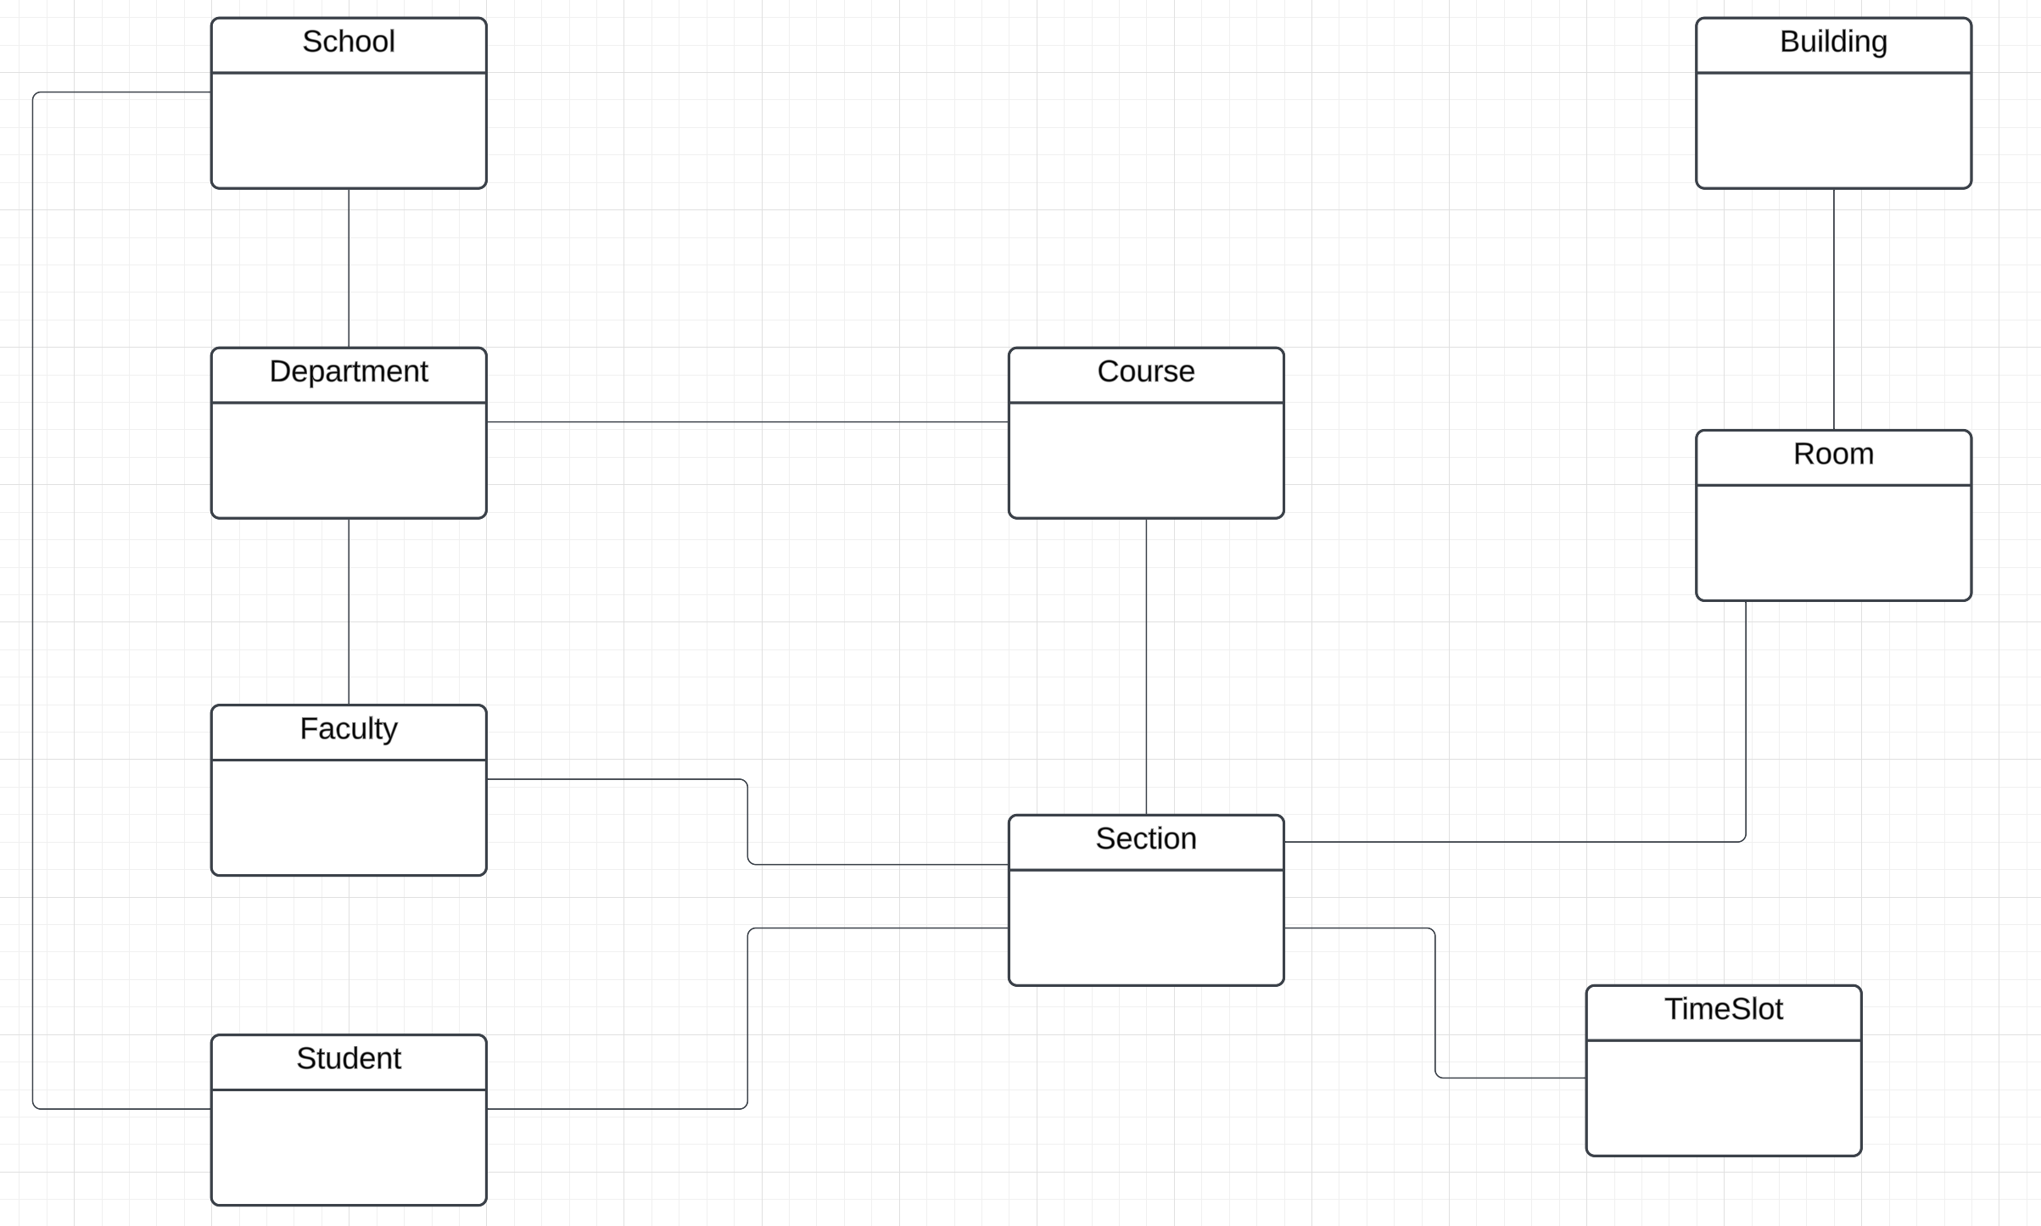
Modeling Columbia Courses – Conceptual

Slide 22
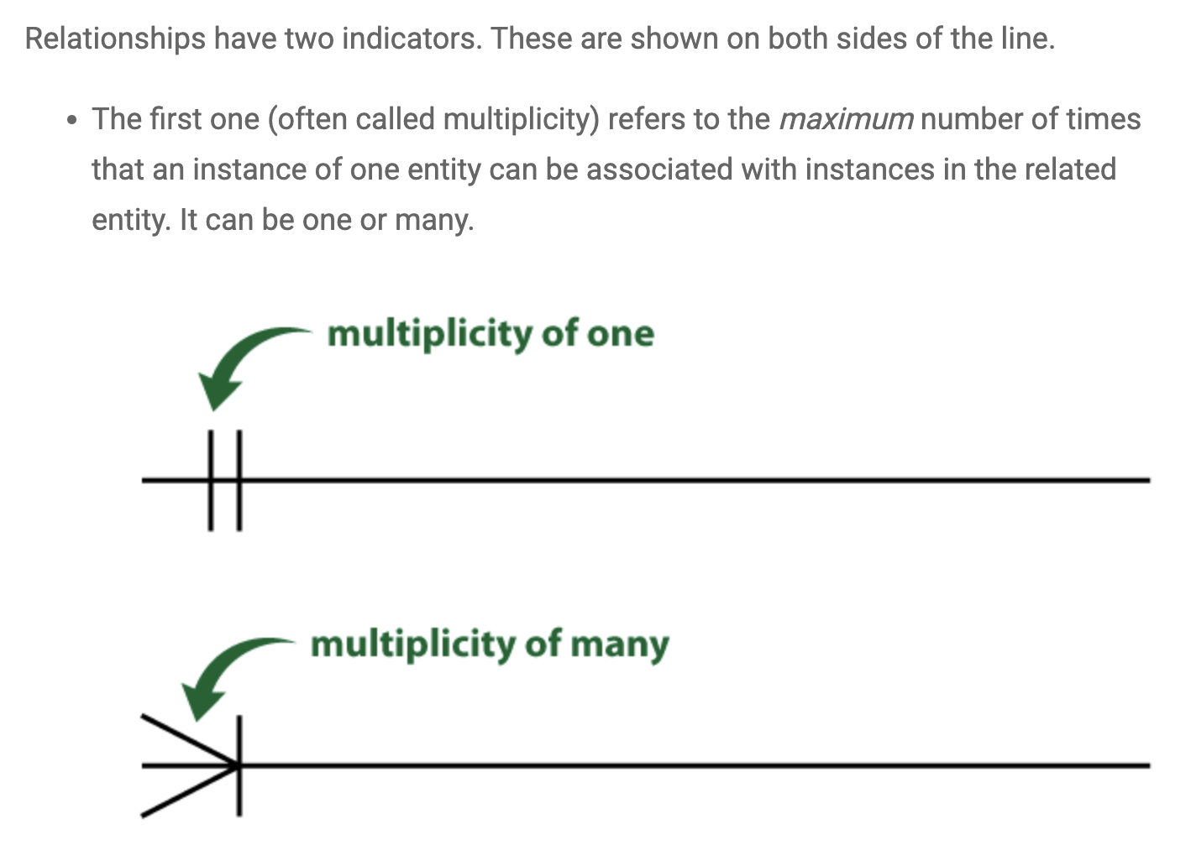
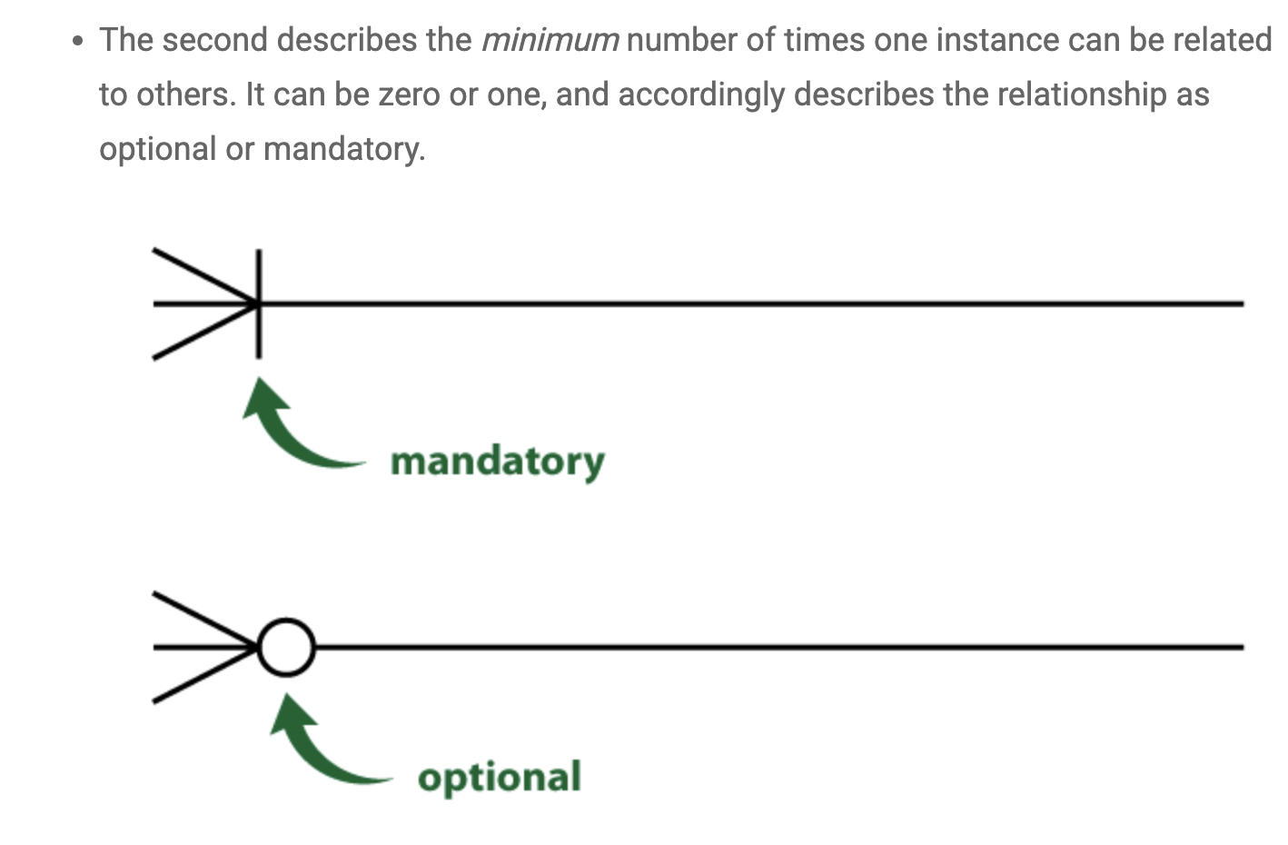
Crow’s Foot Notation
https://vertabelo.com/blog/crow-s-foot-notation/

Slide 23
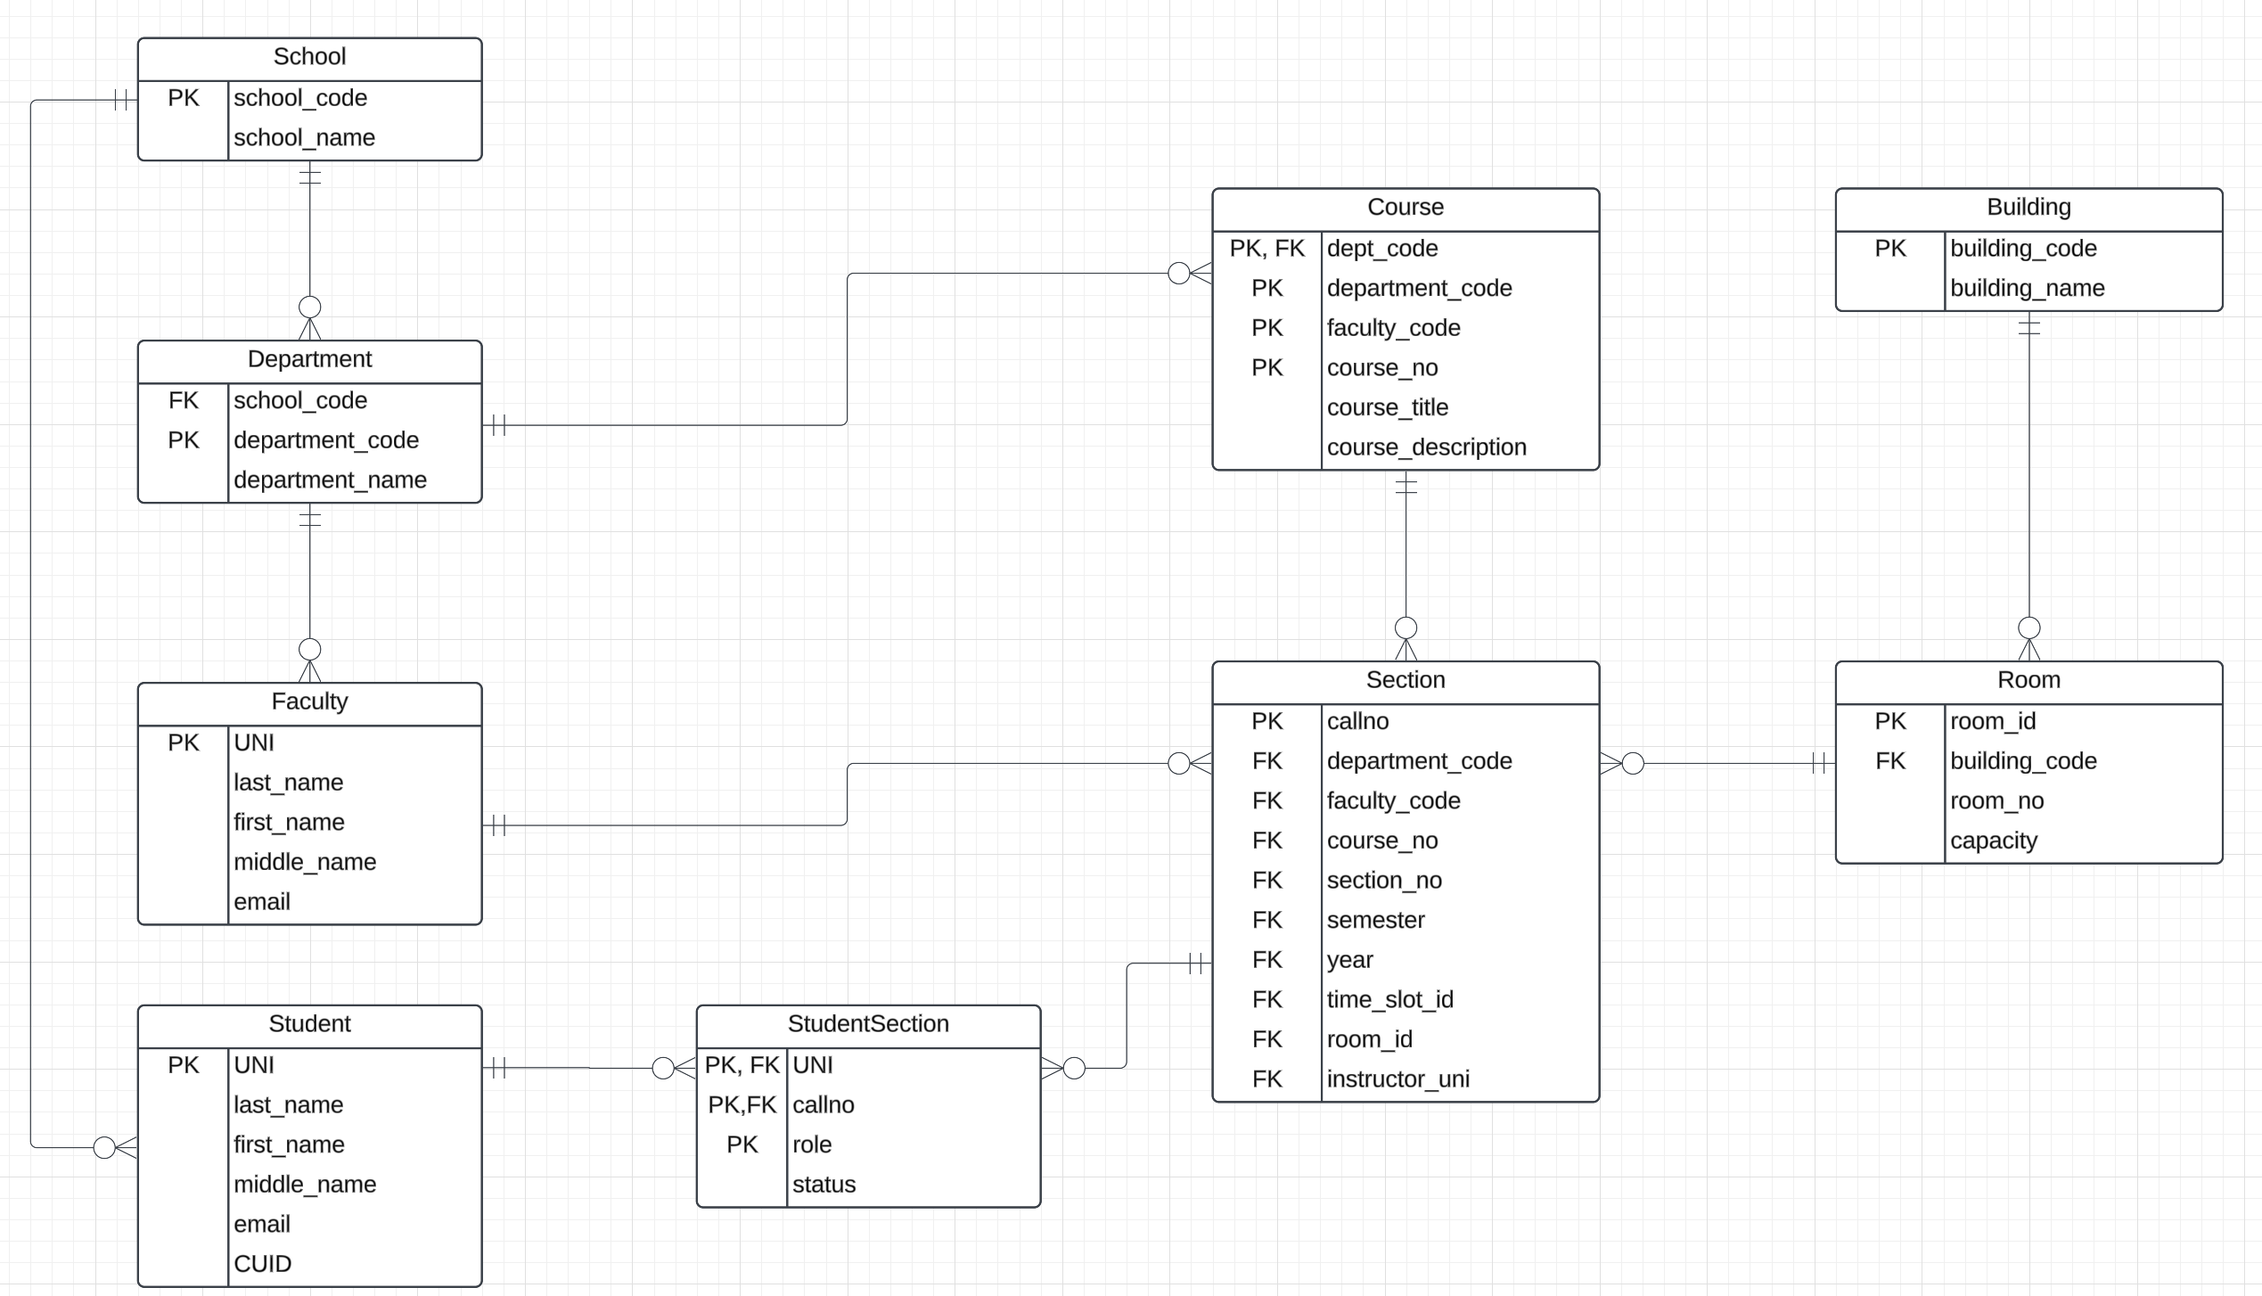
Modeling Columbia Courses – Logical
You usually figure out if this is correct when you define in SQL and test use cases.

Slide 24
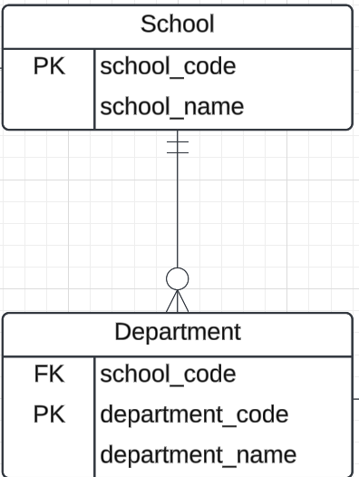
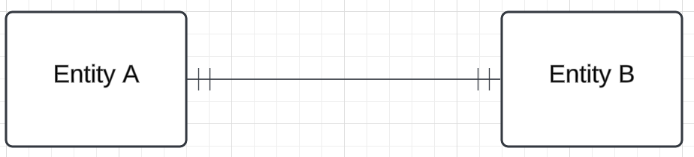
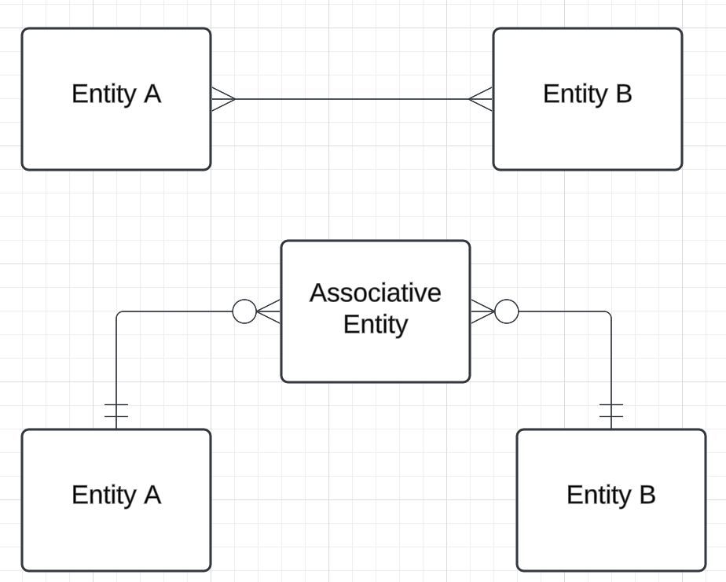
Some Observations
Foreign keys can be confusing and seem to sometimes be on the wrong end.
Mandatory on both ends may require two new entities. The SQL INSERT statement operates on one table making INSERT complex. The data is temporarily inconsistent/invalid.
Many-to-Many in SQL requires a 3rd entity called an Associative Entity.
For Example Mandatory on this end implies Not-NULL, FK on this end.

Slide 25
Keys

Slide 26
What are these Keys of which You Speak?

Slide 27
Keys
Let K ⊆ R
K is a superkey of R if values for K are sufficient to identify a unique tuple of each possible relation r(R)
Example: {ID} and {ID,name} are both superkeys of instructor.
Superkey K is a candidate key if K is minimal Example: {ID} is a candidate key for Instructor
One of the candidate keys is selected to be the primary key.
which one?
Foreign key constraint: Value in one relation must appear in another
Referencing relation
Referenced relation
Example: dept_name in instructor is a foreign key from instructor referencing department

Slide 28
Our Model
Student has three candidate keys:
UNI
CUID
email
Faculty has two candidate keys:
UNI
email
Section has two candidate keys:
callno
The combination of (dept_code, faculty_code, course_no, section_no, semester, year)
Some types of key:
UNI, CUID, callno are surrogate keys as opposed to natural keys.
email and (dept_code, faculty_code, course_no, section_no, semester, year) are natural keys,

Slide 29
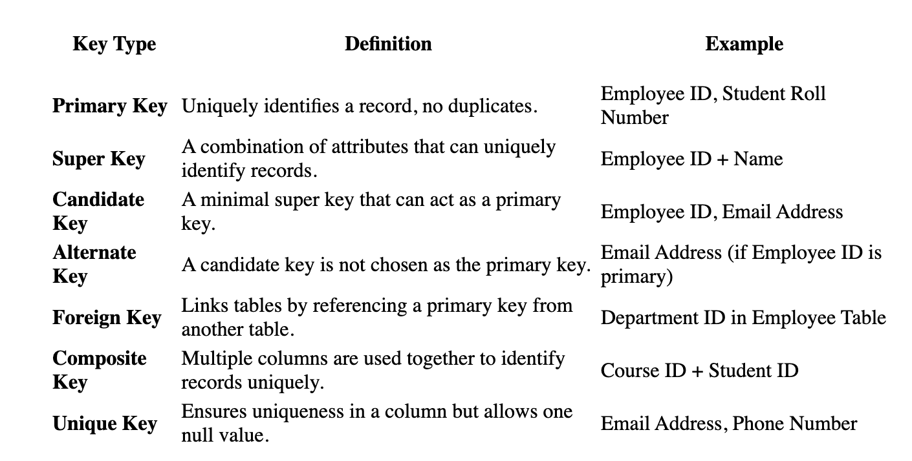
Types of/Patterns for Keys
Primary Keys are Recommended to be immutable.
You may also here the term compound key ➔ Each of the attributes is a foreign key.

Slide 30
Relational Model Relational Algebra

Slide 31
Relational Algebra
A procedural (? Declarative) language consisting of a set of operations that take one or two relations as input and produce a new relation as their result.
Six basic operators
select: σ
project: ∏
union: ∪
set difference: –
Cartesian product: x
JOIN (⨝)
rename: ρ
Covered last week.
Let’s do some practice with the dreaded RelaX calculator.
Note that the RelaX calculator has an extended set of noncore operators.

Slide 32
Let’s Watch Professor Ferguson Do Examples
Let’s do some practice with the dreaded RelaX calculator.
Pay attention to see how I use the “out of data” dataset associated with the recommended textbook.
Note that the RelaX calculator has an extended set of noncore operators.
Get the names of the departments with a budget >= 100000 or in the building ‘Painter’
π dept_name
(σ budget ≥ 100000 ∨ building = 'Painter' (department))
Rename attributes and operate on attributes in π
π the_course_id←course_id,
sec_id, year, something_weird←sec_id+year
(section)
Notes:
Select comparators from the menu, e.g. ≥.
Single quote matters.
Unlike SQL, strings are case sensitive.
Formally, relational algebra use subscript but this is hard to type.

Slide 33
The Dreaded Relax Calculator
Let’s look at an online tool that you will use.
RelaX (https://dbis-uibk.github.io/relax/calc/local/uibk/local/0)
The calculator:
Has an older version of the data from the recommended textbook. (https://dbis-uibk.github.io/relax/calc/gist/4f7866c17624ca9dfa85ed2482078be8/relax-silberschatz-english.txt/0)
You can also upload new data.
Some queries:
σ dept_name='Comp. Sci.' ∨ dept_name='History' (department)
π name, dept_name (instructor)
π ID, name ( σ dept_name='Comp. Sci.' (instructor) )

Slide 34
Cartesian-Product Operation
The Cartesian-product operation (denoted by X) allows us to combine information from any two relations.
Example: the Cartesian product of the relations instructor and teaches is written as:
instructor X teaches
We construct a tuple of the result out of each possible pair of tuples: one from the instructor relation and one from the teaches relation (see next slide)
Since the instructor ID appears in both relations we distinguish between these attribute by attaching to the attribute the name of the relation from which the attribute originally came.
instructor.ID
teaches.ID
R x R -> R f(x,y)->z

Slide 35
Composition of Relational Operations
The result of a relational-algebra operation is relation and therefore of relational-algebra operations can be composed together into a relational-algebra expression.
Consider the query -- Find the names of all instructors in the Physics department.
∏_{name}(σ _{dept_name} _{=“Physics”} (instructor))
Instead of giving the name of a relation as the argument of the projection operation, we give an expression that evaluates to a relation.

Slide 36
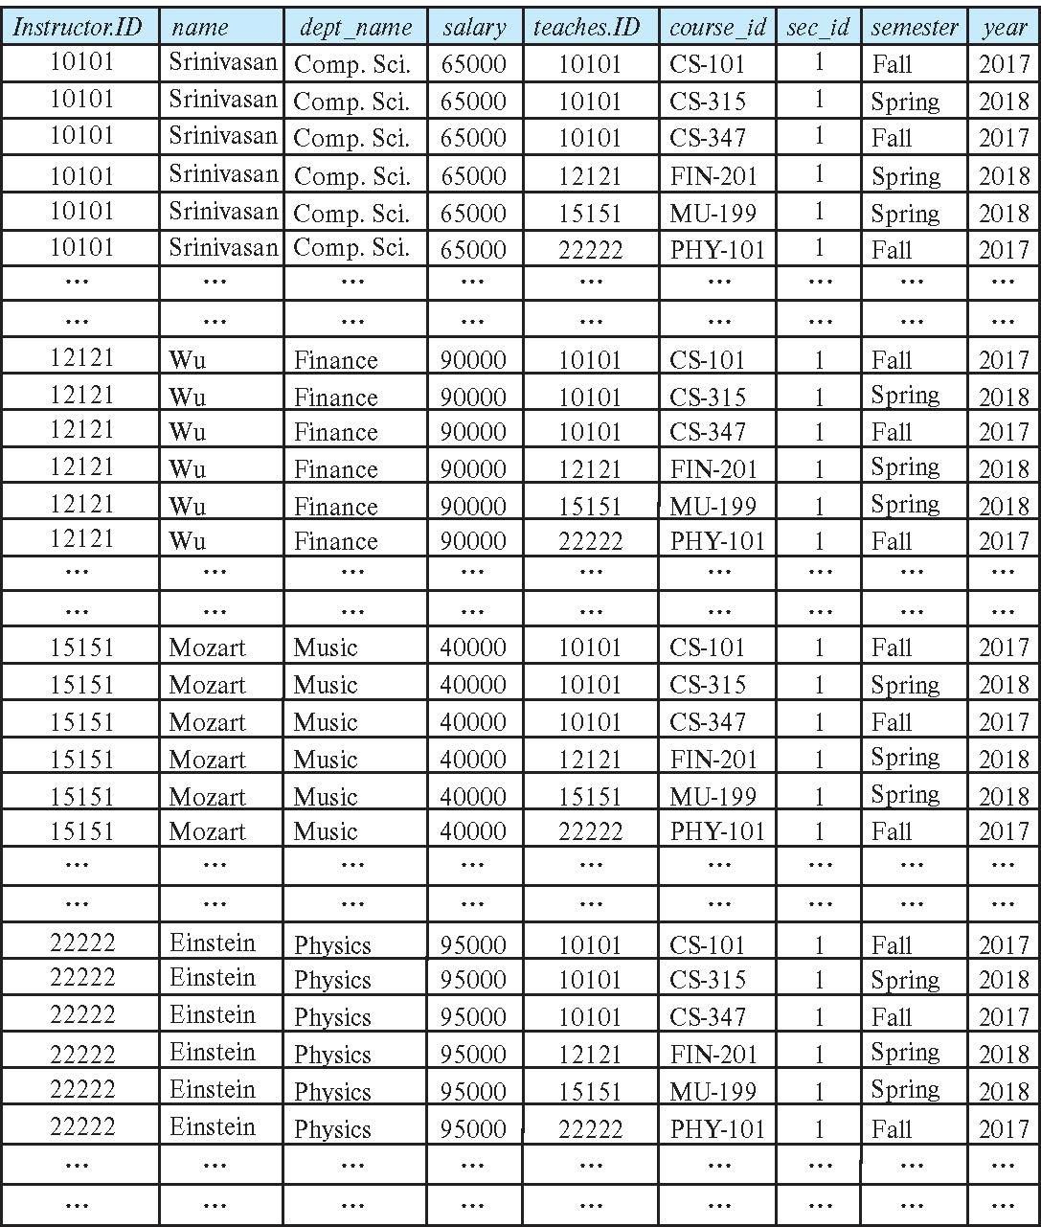
The instructor X teaches table
This only sort of makes sense. The result is:
Every possible combination of the form
(instructor, teaches)
Even if the instructor is NOT the instructor in the teaches row.
Examining in SQL makes a little clearer.
We will see in later in this lecture.
Confusingly, in SQL cartesian Product is JOIN but there is also a relational JOIN operator.

Slide 37
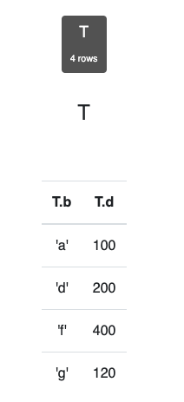
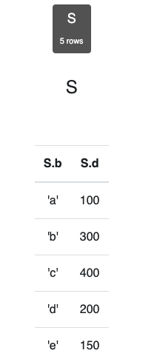
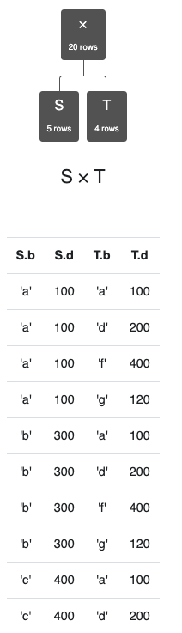
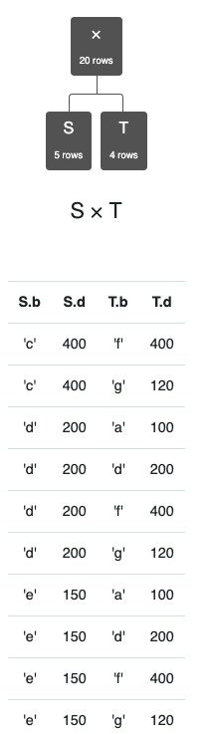
Simpler Example
Assume we have two tables
S has two columns, 5 rows.
T has two columns, 4 rows.
S x T has
4 columns.
20 rows.
Cartesian product does not come up a lot in applications.
There are cases in optimization and other scenarios in which:
You want to generate all possible combinations.
Score, rate, rank etc. to determine best choices.

Slide 38
Join Operation
The Cartesian-Product
instructor X teaches
associates every tuple of instructor with every tuple of teaches.
Most of the resulting rows have information about instructors who did NOT teach a particular course.
To get only those tuples of “instructor X teaches “ that pertain to instructors and the courses that they taught, we write:
σ _{instructor.id = teaches.id} (instructor x teaches ))
We get only those tuples of “instructor X teaches” that pertain to instructors and the courses that they taught.
The result of this expression, shown in the next slide
A fundamental definition:
σ _{instructor.ID=teaches.ID} (instructor ⨯ teaches) = instructor ⨝ teaches
⨝ is the JOIN operations.

Slide 39
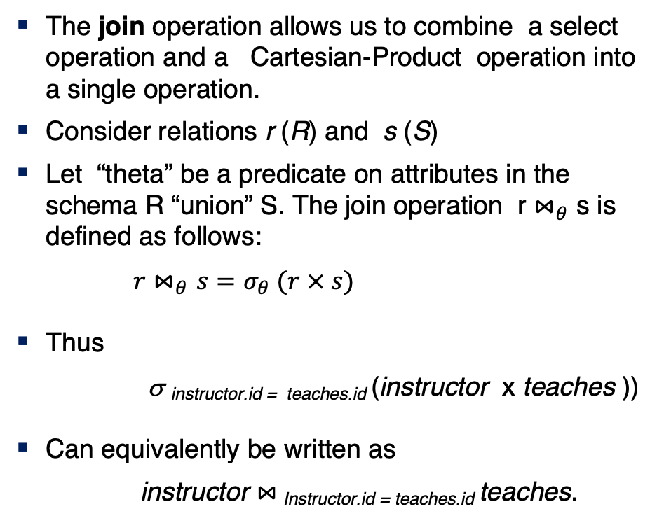
Join Operation (Cont.)
The join operation allows us to combine a select operation and a Cartesian-Product operation into a single operation.
Consider relations r (R) and s (S)
Let “theta” be a predicate on attributes in the schema R “union” S. The join operation r $⋈_{θ}$ s is defined as follows:
$r⋈_{θ}s=σ_{θ} (r × s)$
Thus
σ _{instructor.id = teaches.id} (instructor x teaches ))
Can equivalently be written as
instructor $⋈_{ }$_{Instructor.id = teaches.id} teaches.

Slide 40
Let’s Watch Professor Ferguson Do Examples
More fun with RelaX
Validate the definition with an example
σ instructor.dept_name=department.dept_name (instructor ⨯ department)
instructor ⨝ department
instructor ⨝ instructor.dept_name=department.dept_name department
Note: You sometimes have to fully qualify attribute names.
Let’s pull it all together … …
σ instructor_department='Comp. Sci.'
(
π
instructor_id←instructor.ID, instructor_name←instructor.name,
instructor_department←instructor.dept_name, s_id
(instructor ⨝ instructor.ID=i_id advisor)
⨝ student_id=s_id
(π
student_id←student.ID, student_name←student.name,
student_department←student.dept_name (student)) )
Notes:
Show them how to break this down Barney Style.
Show them approaches to testing and verifying.
Being able to verify is CRITICAL if you use generative AI.

Slide 41
SQL

Slide 42
SQL Parts
DML -- provides the ability to query information from the database and to insert tuples into, delete tuples from, and modify tuples in the database.
integrity – the DDL includes commands for specifying integrity constraints.
View definition -- The DDL includes commands for defining views.
Transaction control –includes commands for specifying the beginning and ending of transactions.
Embedded SQL and dynamic SQL -- define how SQL statements can be embedded within general-purpose programming languages.
Authorization – includes commands for specifying access rights to relations and views.

Slide 43
SQL Language Statements
The core SQL language statements are:
SELECT: Implements both σ, π
INSERT
UPDATE
DELETE
CREATE TABLE
ALTER TABLE
JOIN, which is an operator within SELECT.
Many, if not most, SQL statements:
Implement multiple relational algebra expressions.
Cannot easily (or at all) be represented in relational algebra.
π ID, name ( σ dept_name='Comp. Sci.' (instructor) )
=
SELECT ID, name FROM instructor WHERE
dept_name=‘Comp. Sci.’

Slide 44
Basic Query Structure
A typical SQL query has the form: select A₁, A₂, ..., A_{n} from r₁, r₂, ..., r_{m} where P
A_{i} represents an attribute
R_{i} represents a relation
P is a predicate.
The result of an SQL query is a relation.
Multiple tables and cause confusion and errors because you are doing a cross=product.
Be careful
Note:
The SELECT ... FROM ... WHERE ... Combines two relational operators, σ and ∏.
Actually, it also combines other operators, e.g. x
Notes:
2

Slide 45
The select Clause
The select clause lists the attributes desired in the result of a query
corresponds to the projection operation of the relational algebra
Example: find the names of all instructors: select name from instructor
NOTE: SQL names are case insensitive (i.e., you may use upper- or lower-case letters.)
E.g., Name ≡ NAME ≡ name
Some people use upper case wherever we use bold font.
Notes:
3

Slide 46
The select Clause (Cont.)
SQL allows duplicates in relations as well as in query results.
To force the elimination of duplicates, insert the keyword distinct after select.
Find the department names of all instructors, and remove duplicates
select distinct dept_name from instructor
The keyword all specifies that duplicates should not be removed.
select all dept_name from instructor
Notes:
4

Slide 47
The select Clause (Cont.)
An asterisk in the select clause denotes “all attributes”
select * from instructor
An attribute can be a literal with no from clause
select '437'
Results is a table with one column and a single row with value “437”
Can give the column a name using:
select '437' as FOO
An attribute can be a literal with from clause
select 'A' from instructor
Result is a table with one column and N rows (number of tuples in the instructors table), each row with value “A”
Notes:
5

Slide 48
The select Clause (Cont.)
The select clause can contain arithmetic expressions involving the operation, +, –, ∗, and /, and operating on constants or attributes of tuples.
The query:
select ID, name, salary/12 from instructor
would return a relation that is the same as the instructor relation, except that the value of the attribute salary is divided by 12.
Can rename “salary/12” using the as clause:
select ID, name, salary/12 as monthly_salary
Notes:
5

Slide 49
The where Clause
The where clause specifies conditions that the result must satisfy
Corresponds to the selection predicate of the relational algebra.
To find all instructors in Comp. Sci. dept
select name from instructor where dept_name = 'Comp. Sci.'
SQL allows the use of the logical connectives and, or, and not
The operands of the logical connectives can be expressions involving the comparison operators <, <=, >, >=, =, and <>.
Comparisons can be applied to results of arithmetic expressions
To find all instructors in Comp. Sci. dept with salary > 80000
select name from instructor where dept_name = 'Comp. Sci.' and salary > 80000
Notes:
6

Slide 50
The from Clause
The from clause lists the relations involved in the query
Corresponds to the Cartesian product operation of the relational algebra.
Find the Cartesian product instructor X teaches
select ∗ from instructor, teaches
generates every possible instructor – teaches pair, with all attributes from both relations.
For common attributes (e.g., ID), the attributes in the resulting table are renamed using the relation name (e.g., instructor.ID)
Cartesian product not very useful directly, but useful combined with where-clause condition (selection operation in relational algebra).
Notes:
8

Slide 51
Examples
Find the names of all instructors who have taught some course and the course_id
select name, course_id from instructor , teaches where instructor.ID = teaches.ID
Find the names of all instructors in the Art department who have taught some course and the course_id
select name, course_id from instructor , teaches where instructor.ID = teaches.ID and instructor. dept_name = 'Art'
Notes:
9

Slide 52
Data Definition Language
The SQL data-definition language (DDL) allows the specification of information about relations, including:
The schema for each relation.
The type of values associated with each attribute.
The Integrity constraints
The set of indices to be maintained for each relation.
Security and authorization information for each relation.
The physical storage structure of each relation on disk.

Slide 53
Create Table Construct
An SQL relation is defined using the create table command:
create table r
(A₁ D₁, A₂ D₂, ..., A_{n} D_{n}, (integrity-constraint₁), ..., (integrity-constraint_{k}))
r is the name of the relation
each A_{i} is an attribute name in the schema of relation r
D_{i} is the data type of values in the domain of attribute A_{i}
Example:
create table instructor ( ID char(5), name varchar(20), dept_name varchar(20), salary numeric(8,2))

Slide 54
The Rename Operation
The SQL allows renaming relations and attributes using the as clause:
old-name as new-name
Find the names of all instructors who have a higher salary than some instructor in 'Comp. Sci'.
select distinct T.name from instructor as T, instructor as S where T.salary > S.salary and S.dept_name = 'Comp. Sci.’
Keyword as is optional and may be omitted instructor as T ≡ instructor T
This is an example of using Cartesian Product.
Notes:
9

Slide 55
Null Values
It is possible for tuples to have a null value, denoted by null, for some of their attributes
null signifies an unknown value or that a value does not exist.
The result of any arithmetic expression involving null is null
Example: 5 + null returns null
The predicate is null can be used to check for null values.
Example: Find all instructors whose salary is null.
select name from instructor where salary is null
The predicate is not null succeeds if the value on which it is applied is not null.
Note:
NULL is an extremely important concept.
You will find it hard to understand for a while.

Slide 56
Null Values (Cont.)
SQL treats as unknown the result of any comparison involving a null value (other than predicates is null and is not null).
Example: 5 < null or null <> null or null = null
The predicate in a where clause can involve Boolean operations (and, or, not); thus the definitions of the Boolean operations need to be extended to deal with the value unknown.
and : (true and unknown) = unknown, (false and unknown) = false, (unknown and unknown) = unknown
or: (unknown or true) = true, (unknown or false) = unknown (unknown or unknown) = unknown
Result of where clause predicate is treated as false if it evaluates to unknown

Slide 57
Modification of the Database
Deletion of tuples from a given relation.
Insertion of new tuples into a given relation
Updating of values in some tuples in a given relation

Slide 58
Deletion
Delete all instructors
delete from instructor
Delete all instructors from the Finance department delete from instructor where dept_name= 'Finance’;
Delete all tuples in the instructor relation for those instructors associated with a department located in the Watson building.
delete from instructor where dept name in (select dept name from department where building = 'Watson');

Slide 59
Deletion (Cont.)
Delete all instructors whose salary is less than the average salary of instructors
Problem: as we delete tuples from instructor, the average salary changes
Solution used in SQL:
First, compute avg (salary) and find all tuples to delete
Next, delete all tuples found above (without recomputing avg or retesting the tuples)
delete from instructor
where salary < (select avg (salary)
from instructor);

Slide 60
Insertion
Add a new tuple to course
insert into course values ('CS-437', 'Database Systems', 'Comp. Sci.', 4);
or equivalently
insert into course (course_id, title, dept_name, credits) values ('CS-437', 'Database Systems', 'Comp. Sci.', 4);
Add a new tuple to student with tot_creds set to null
insert into student values ('3003', 'Green', 'Finance', null);

Slide 61
Insertion (Cont.)
Make each student in the Music department who has earned more than 144 credit hours an instructor in the Music department with a salary of $18,000.
insert into instructor select ID, name, dept_name, 18000 from student where dept_name = 'Music' and total_cred > 144;
The select from where statement is evaluated fully before any of its results are inserted into the relation.
Otherwise queries like
insert into table1 select * from table1
would cause problem

Slide 62
Updates
Give a 5% salary raise to all instructors
update instructor set salary = salary * 1.05
Give a 5% salary raise to those instructors who earn less than 70000 update instructor set salary = salary * 1.05 where salary < 70000;
Give a 5% salary raise to instructors whose salary is less than average
update instructor set salary = salary * 1.05 where salary < (select avg (salary) from instructor);

Slide 63
Updates (Cont.)
Increase salaries of instructors whose salary is over $100,000 by 3%, and all others by a 5%
Write two update statements:
update instructor set salary = salary * 1.03 where salary > 100000; update instructor set salary = salary * 1.05 where salary <= 100000;
The order is important
Can be done better using the case statement (next slide)

Slide 64
Case Statement for Conditional Updates
Same query as before but with case statement
update instructor set salary = case when salary <= 100000 then salary * 1.05 else salary * 1.03 end

Slide 65
Joined Relations
Join operations take two relations and return as a result another relation.
A join operation is a Cartesian product which requires that tuples in the two relations match (under some condition). It also specifies the attributes that are present in the result of the join
The join operations are typically used as subquery expressions in the from clause
Three types of joins:
Natural join
Inner join
Outer join
Notes:
You will also hear terms like equi-join, non-equi-join, theta join, semi-join, ... ...
I ask for definitions on exams, but you can just look them up.

Slide 66
Natural Join in SQL
Natural join matches tuples with the same values for all common attributes, and retains only one copy of each common column.
List the names of instructors along with the course ID of the courses that they taught
select name, course_id from students, takes, where student.ID = takes.ID;
Same query in SQL with “natural join” construct
select name, course_id from student natural join takes;

Slide 67
Natural Join in SQL (Cont.)
The from clause can have multiple relations combined using natural join:
select A₁, A₂, … A_{n} from r₁ natural join r₂ natural join .. natural join r_{n} where P ;

Slide 68
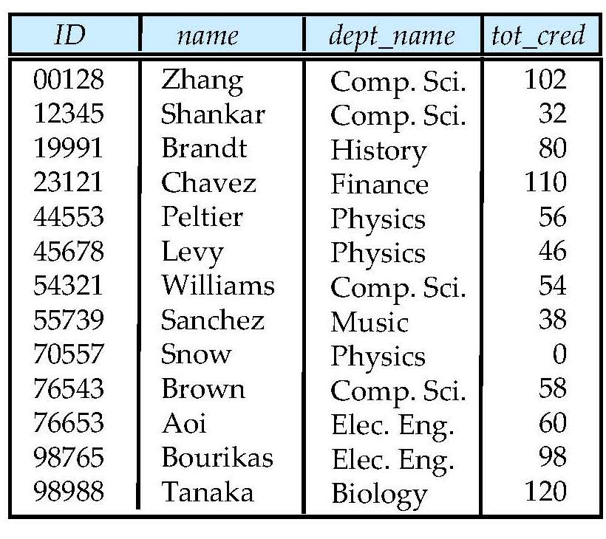
Student Relation

Slide 69
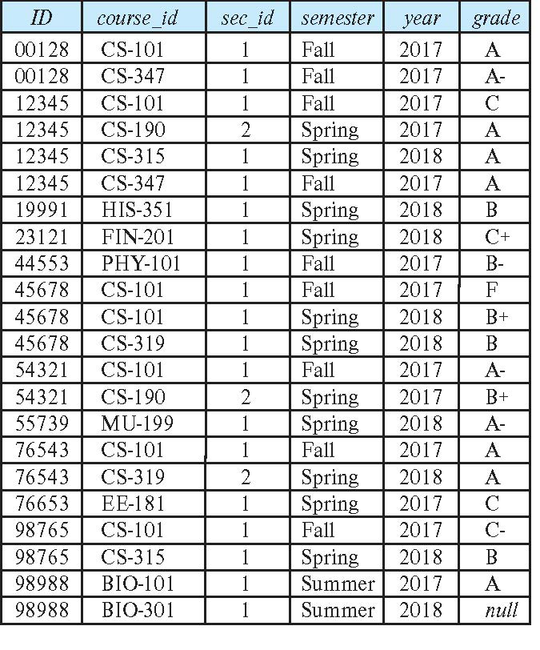
Takes Relation

Slide 70
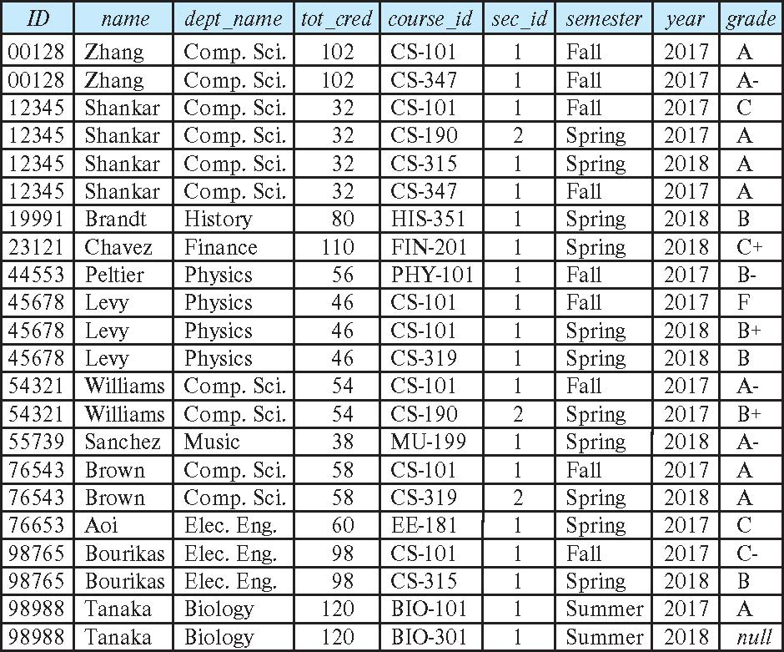
student natural join takes

Slide 71
Dangerous in Natural Join
Beware of unrelated attributes with same name which get equated incorrectly
Example -- List the names of students instructors along with the titles of courses that they have taken
Correct version
select name, title from student natural join takes, course where takes.course_id = course.course_id;
Incorrect version
select name, title from student natural join takes natural join course;
This query omits all (student name, course title) pairs where the student takes a course in a department other than the student's own department.
The correct version (above), correctly outputs such pairs.

Slide 72
Natural Join with Using Clause
To avoid the danger of equating attributes erroneously, we can use the “using” construct that allows us to specify exactly which columns should be equated.
Query example
select name, title from (student natural join takes) join course using (course_id)

Slide 73
Join Condition
The on condition allows a general predicate over the relations being joined
This predicate is written like a where clause predicate except for the use of the keyword on
Query example
select * from student join takes on student_ID = takes_ID
The on condition above specifies that a tuple from student matches a tuple from takes if their ID values are equal.
Equivalent to:
select * from student , takes where student_ID = takes_ID

Slide 74
Join Condition (Cont.)
The on condition allows a general predicate over the relations being joined.
This predicate is written like a where clause predicate except for the use of the keyword on.
Query example
select * from student join takes on student_ID = takes_ID
The on condition above specifies that a tuple from student matches a tuple from takes if their ID values are equal.
Equivalent to:
select * from student , takes where student_ID = takes_ID

